Slide 1




GLOBAL SUPErstores
Project by -
Mentor Name
Name Institute
State
PAYAL RAJ
ABHISHEK G
NSTI BENGALURU
KARNATAKA

Slide 2

Agenda
Problem Statement
Who are the end Users
Proposed solutions
Wow Analytics in the solution
Dashboard Demonstration
Conclusion
Notes:
project overview provides stakeholders and team members with a clear understanding of the project's purpose, scope, and expectations, setting the stage for successful project execution and delivery.

Slide 3

Problem statement
Global Superstores, a multinational retail company, is facing challenges in analyzing its profit and sales data effectively.
Without a clear understanding of their profit margins and sales trends, Global Superstores is at risk of losing competitive advantage in the market.
Notes:
aim to leverage Power BI's capabilities to transform data into actionable insights, drive business performance, and support organizational goals and objectives.

Slide 4


Who are the end users
Stakeholders
Sales and Marketing teams: Analyzing customer behaviour and optimizing campaigns
Management : Strategic decision-makers
Customer service representatives
Operations and supply chain managers
Consumers and retailers

Slide 5


Proposed Solution-
Use line charts or area charts to show the trend of sales and profit over multiple years, highlighting any significant fluctuations or patterns.
Use bar charts or waterfall charts to visualize the profitability of each market by year.
Utilize color gradients or proportional symbols to represent profit volumes in different markets visually.

Slide 6
Wow Analytics in the Solution
Highest Sales and Profit Analysis:
Sales in 2015 =4.3 M
Profit in 2015=0.50 M
Variations in Global Superstore:
Analyze variations in sales and profit for the global superstore, focusing on the years 2012, 2013, 2014 and 2015.
Predictive Analytics for Future Trends:
Predictive analytics models to forecast future sales and profit trends based on historical data help users to anticipate future performance.

Slide 7
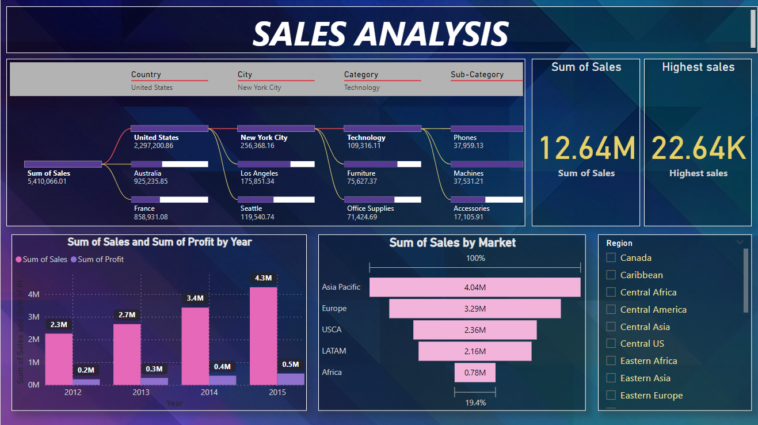
SALES ANALYSIS
Sum of sales
12.64M
Highest Sales by Market Asia Pacific
4.04M
Minimum Sales(2.3M) and Profit(0.2M) in 2012
Maximum Sales
22.64K

Slide 8
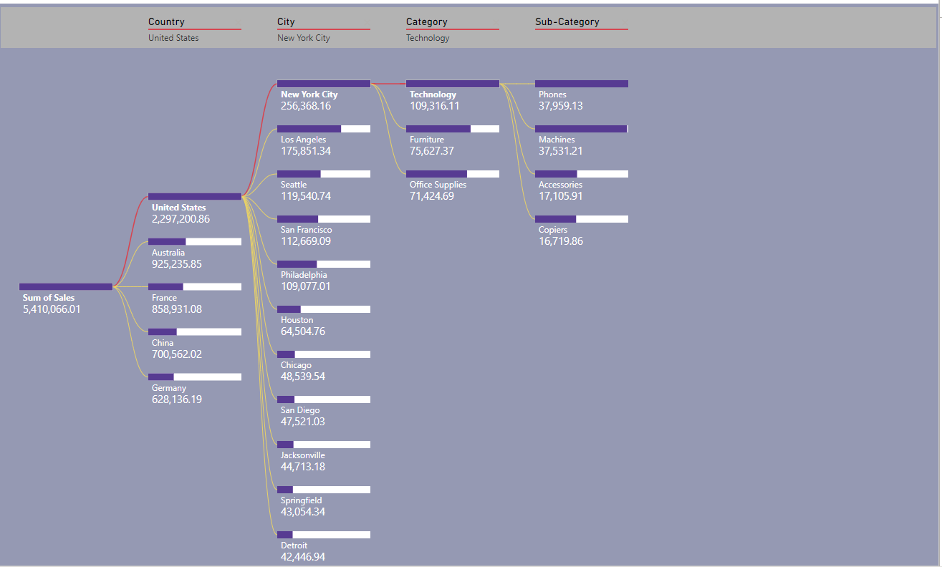
Decomposition tree on sales analysis

Slide 9
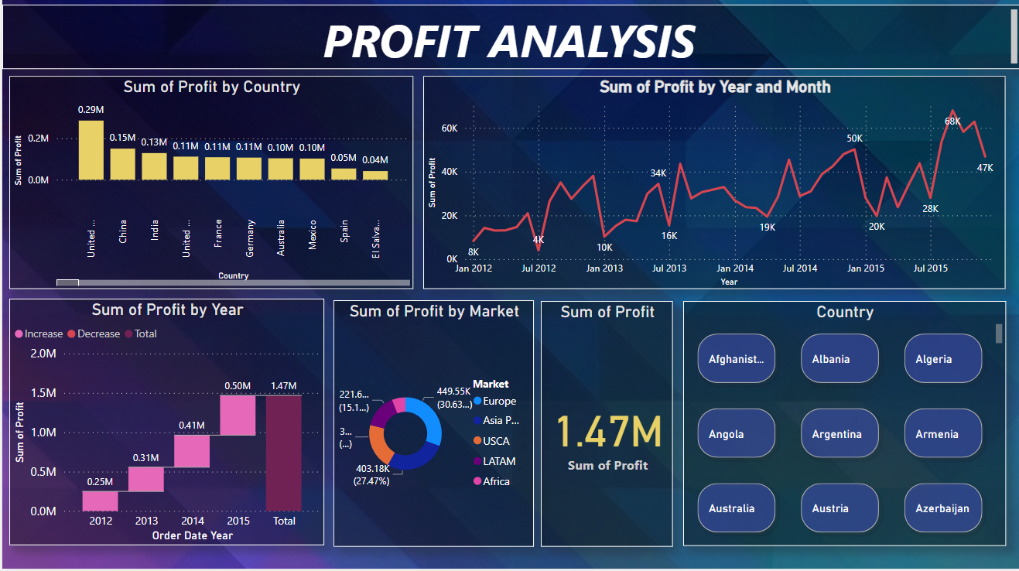
PROFIT ANALYSIS
LATAM(221.64k)
Africa(88.87K)
USCA(304.21K)
Sum of profit by market
Europe(449.55K)
Asia Pacific(403.18K)

Slide 10
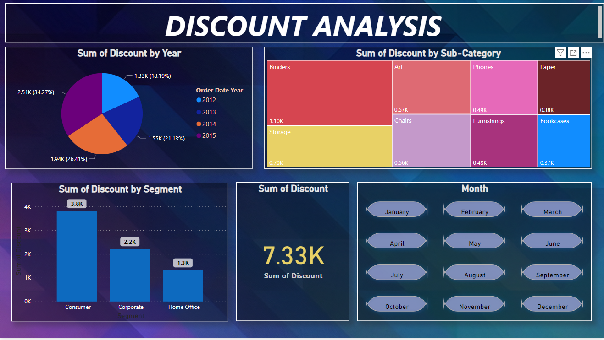
DISCOUNT ANALYSIS
Sum of Discount by year
2012(1.3K)
2015(2.5K)
Sum of Discount by Segment
Consumer(3.8K -highest)
Home Office(1.3K- lowest)
Sum of Discount
7.33K

Slide 11

Conclusion
Enhanced decision-making, improved operational efficiency, and increased competitiveness
Continuous utilization and exploration of Power BI capabilities for further success
This Photo by Unknown author is licensed under CC BY-SA-NC.

Slide 12

Thank you

